Slide 1
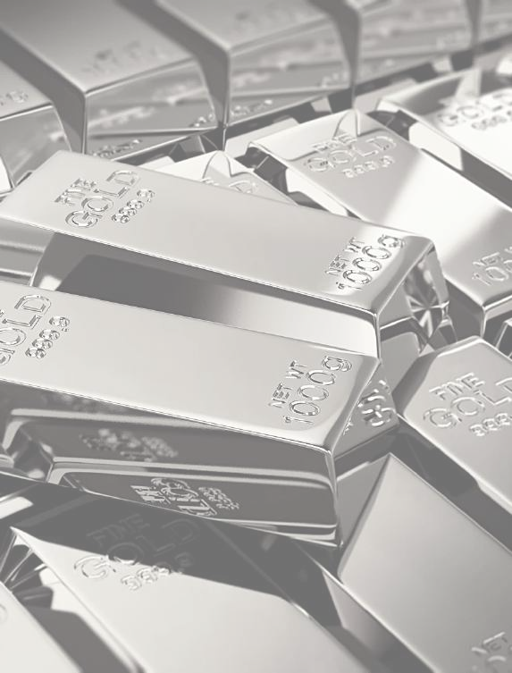
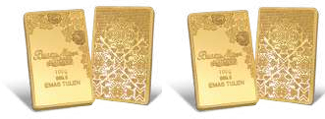
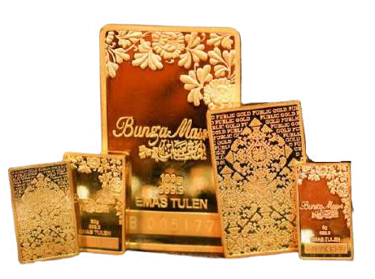
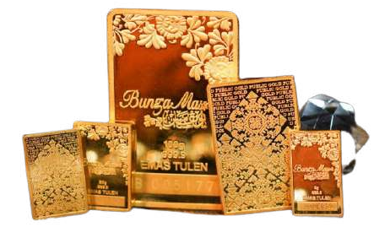
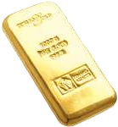
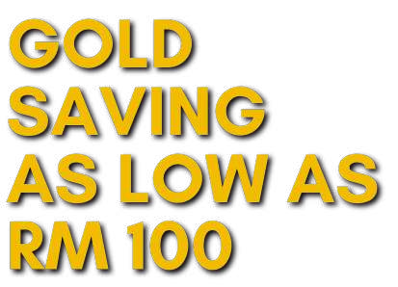
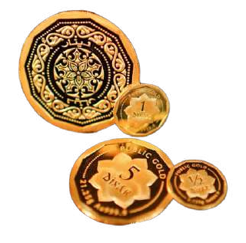
OUTRIGHT PURCHASE
Full Payment
Buy gold with full payment.
Pick up the gold at a Public Gold branch or request insured post.
Keep it yourself.
Shariah Easy Payment Purchase (EPP)
Buy gold with installment payments (6 months or 10 months)
After payment, pick up the gold at a Public Gold branch or request insured post.
Keep it yourself.
21 July 2018 RM17,290.00
3 March 2022 RM27,832.00
Increased by
60.97%
WHAT CAN BE CHANGED IS YOUR ACTIONS TODAY
21 July 2018 RM172,332.00
3 March 2022 RM277,409.00
WHO NEEDS TO SAVE GOLD?
GOLD ACCUMULATION PROGRAM (GAP)
Money earns from salary gone without trace.
Save money but still leaking every month.
Plan to get married in 3 - 4 years. Want to pay off debt within 3 - 4 years.
Plan to perform Hajj/Umrah
Want to provide funds for children's education.
Prepare retirement fund.
Save gold in the account by direct purchase in grams or RM, as low as RM 100.
No monthly commitment.
Gold is kept without any charges and insured.
Can withdraw physical gold anytime and keep it yourself.
Auto Debit option is available for those who want to be disciplined in saving.
GOLD ACCUMULATION PROGRAM (GAP)
Free registration Shariah compliant No commitment Affordable

Slide 2
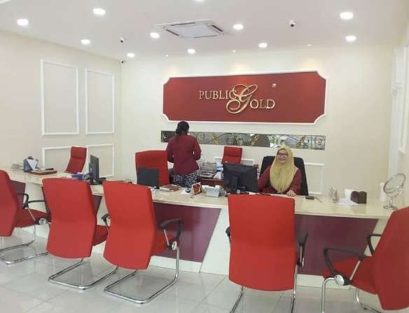
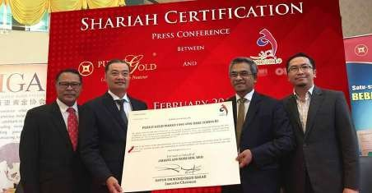
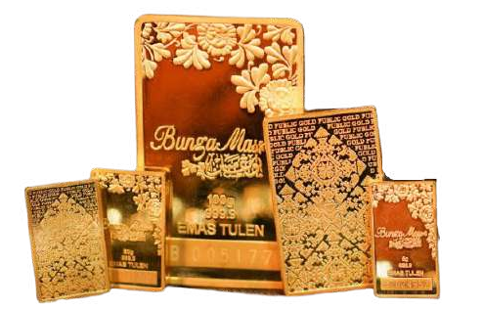
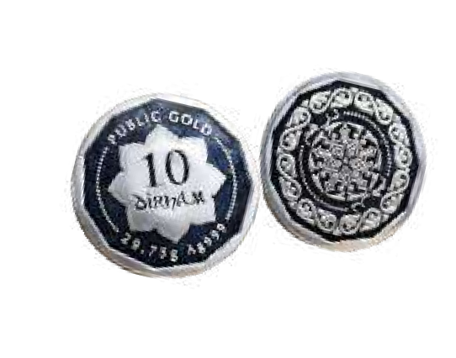
SHARIAH COMPLIANT
All methods of buying and selling Public Gold's gold and silver have been confirmed as shariah compliant by Amanie Advisors under the patronage of YBhg. Tan Sri Dr Mohd Daud Bakar since 2017. Shariah compliant status is audited every year.
The Largest Shariah-Based Physical Gold and Silver Trading Company in Malaysia.
AWARDS & RECOGNITIONS
The most awarded and recognised gold trading company in Malaysia.
Children's education fund
Home/land assets
Marriage
Established since 2008, Public Gold now has 17 branches in Malaysia and 4 branches in Indonesia.
HIGH QUALITY & LOW PRICE
The gold produced is proven to be pure and of high quality; and is offered at a low price which is according to the factory price.
Business capital
Emergency fund
GOLD SAVING GOALS
ONLINE TRANSPARENCY
Has a transparent buying and selling price setting mechanism and a 24/7 online booking system.
Umrah/hajj
Retirement fund
# PUBLICGOLD
# PGG 100 NETWORK # NEXTMOHDZULKIFLI
PHYSICAL GOLD
All Public Gold products are real physical gold that you can see, touch and keep.
Public Gold has nothing to do with Public Bank or
Public Mutual.
CONTACT
The products produced and sold are gold and silver bars, dinars and dirhams.

